Slide 1
Does religion make a difference?
Bernadette Hoffman
Example Majors – Psychology, Theology

Slide 2
Background
The data set used for the following analyses was compiled by the Public Religion Research Institute, in partnership with the American Academy of Religion. It is the result of a survey conducted in 2014. The purpose of the survey was to assess the views on climate change and religion. However, many questions touching on many different facets of life and belief were asked. The data is considered to be whole, accurate and non-biased.
The data set has a sample size of 3023, however due to the nature of many of the questions, many variables contained upwards of 1000 null values, these variables were not used.
Many things can be seen influencing people's politics, views on scientific fact, and views on the world in general. The following analyses will attempt to identify if different religious beliefs have an impact on these views.

Slide 3
Factor Analysis
The variables for this data set are Likert Scale ratings. There was a linear relationship between the variables. There were no significant outliers, and the data appeared to be approaching normality.
Though the data appeared to attempt to categorized most of the questions, there were multiple questions that seemed to correlate with specific topics but were not categorized. Because of this an exploratory analysis was conducted. The data was interpreted using the scree plot, and a varimax rotation. A total of 6 factors were found – environmental concern, belief in god, spirituality, belief in science, reconciliation between science and religion, and current events concern. Only one of the latent variables loaded with multiple factors (belief in God at 0.350, and reconciliation between science and religion at 0.437) , it was kept with factor 5 because of the higher loading value.

Slide 4
Factors
Results
Environmental concern – how much a person is concerned about taking care of the planet and the effects of climate change.
Belief in god – a person's conviction in the knowledge of the existence of a higher being .
Spirituality – universal connection, a sense of being a part of a greater whole that is humanity, feeling a sense of peace from nature.
Belief in science – climate change is a fact, vaccinations are vital, etc.
Reconciliation between science and religion - religious beliefs compromised by scientific fact.
Current events concern – watching the news, reading the paper.
Factor Loadings
 |  | Factor
 |  | 1 |  | 2 |  | 3 |  | 4 |  | 5 |  | 6 |  | Uniqueness
Q1 |  |  |  |  |  |  |  |  |  |  |  | 0.523 |  | 0.717
Q2 |  |  |  |  |  |  |  |  |  |  |  |  |  | 0.971
Q3 |  |  |  |  |  |  |  |  |  |  |  | 0.559 |  | 0.618
Q4 |  |  |  |  |  |  |  |  |  |  |  |  |  | 0.892
Q7 |  |  |  |  |  |  |  | 0.393 |  |  |  |  |  | 0.817
Q10 |  |  |  |  |  |  |  | 0.383 |  |  |  |  |  | 0.750
Q17 |  |  |  | 0.583 |  |  |  |  |  |  |  |  |  | 0.585
Q18 |  |  |  | 0.550 |  |  |  |  |  |  |  |  |  | 0.667
Q20 |  |  |  | 0.648 |  |  |  |  |  |  |  |  |  | 0.538
Q21A |  |  |  |  |  | 0.559 |  |  |  |  |  |  |  | 0.649
Q21B |  |  |  |  |  | 0.546 |  |  |  |  |  |  |  | 0.656
Q21C |  |  |  |  |  | 0.537 |  |  |  |  |  |  |  | 0.663
Q21D |  |  |  |  |  | 0.685 |  |  |  |  |  |  |  | 0.501
Q24A |  |  |  | 0.358 |  |  |  |  |  |  |  |  |  | 0.801
Q24B |  |  |  |  |  |  |  | 0.368 |  |  |  |  |  | 0.770
Q24C |  |  |  |  |  |  |  | 0.518 |  |  |  |  |  | 0.660
Q27 |  |  |  |  |  |  |  |  |  | 0.341 |  |  |  | 0.819
Q28 |  |  |  |  |  |  |  |  |  | 0.381 |  |  |  | 0.762
Q29A |  |  |  | 0.350 |  |  |  |  |  | 0.437 |  |  |  | 0.674
Q29B |  |  |  |  |  |  |  |  |  | 0.354 |  |  |  | 0.838
Q31A |  | 0.611 |  |  |  |  |  |  |  |  |  |  |  | 0.587
Q31B |  | 0.613 |  |  |  |  |  |  |  |  |  |  |  | 0.518
Q31C |  | 0.737 |  |  |  |  |  |  |  |  |  |  |  | 0.405
Q31D |  | 0.747 |  |  |  |  |  |  |  |  |  |  |  | 0.397
Note. 'Minimum residual' extraction method was used in combination with a 'varimax' rotation

Slide 5
Research question and hypothesis
Is there a difference in the 5 factors (environmental concern, belief in god, spirituality, belief in science, reconciliation between science and religion, current events concern) within different religious beliefs (1 -Protestant, 2 - Roman Catholic, 3 - other (Mormon, Orthodox, Muslim, Buddhist, etc.), 4 - Jewish, 5 - Agnostic/Atheist)?
Null Hypothesis: There is no difference.
Research Hypothesis: There is a difference.

Slide 6
Method
A MANOVA was conducted to compare the effect of religious affiliation on environmental concern, belief in god, spirituality, belief in science, reconciliation between science and religion, and current events concern domains. There was a significant effect of religion on the environmental concern, belief in god, spirituality, belief in science, reconciliation between science and religion, and current events concern domains, F(24, 11756) = 2.51, p < 0.001, Pillai’s Trace = 0.201.

Slide 7
Further Analysis – Belief in God
An ANOVA was conducted to compare the effect of religion type on belief in god in Protestant, Roman Catholic, Other, Jewish, and Agnostic belief systems. There was a significant effect of religion on belief in god at the p < .05 level for the five religious affiliations, F(4,2941) = 111, p < .001, η_{p}² = .131. Post hoc comparisons using the Bonferroni test indicated that the mean score for Protestant (M = 2.00, SD = 1.02) was significantly different from other (M = 2.33, SD = 1.21), Jewish (M = 2.87 SD = 1.14), and Agnostic (M = 2.97, SD = 1.06). Post hoc comparisons using the Bonferroni test indicated that the mean score for Roman Catholic (M = 2.08, SE = .91) was significantly different from Jewish (M = 2.87, SE = 1.14) , and Agnostic (M = 2.97, SD = 1.06). Post hoc comparisons using the Bonferroni test indicated that the mean score for other (M = 2.33, SD = 1.21) was significantly different from Jewish (M = 2.87 SD = 1.14), and Agnostic (M = 2.97, SD = 1.06). However, Protestant (M = 2.00, SD = 1.02) did not differ from Roman Catholic (M = 2.08, SE = .91). Roman Catholic (M = 2.08, SE = .91) did not differ from other (M = 2.33, SD = 1.21), and Jewish (M = 2.87, SE = 1.14) did not differ from Agnostic (M = 2.97, SD = 1.06).

Slide 8


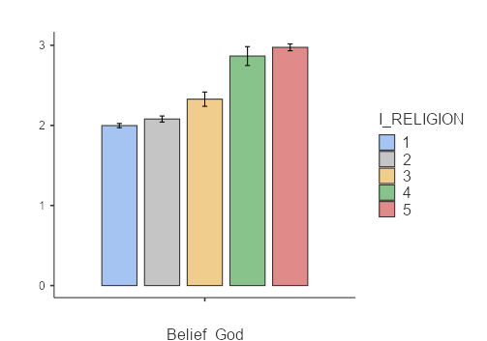
Discussion – Belief in God
It should be noted that for this factor the higher the rating the less one’s belief in god, the lower, the greater one’s belief in god. This seems to indicate that belief in god still varies by religious convictions. Though for the most part, belief in god is similar for Protestants(1) and Catholics(2), there is a clear difference for other(3) (which included non-denominational, Mormon, Muslim, Buddhist, etc.), and Jewish(4). This also aligns with the fact that Agnostic/Atheists(5) rank highest in lack of belief in god. It is also interesting that belief in god for those identifying as Jewish is rather close to that of Agnostic Atheists, this could be because being Jewish is considered by many to be their heritage rather than a religious belief system.

Slide 9
Further Analysis – belief in science
An ANOVA was conducted to compare the effect of religion type on belief in science in Protestant, Roman Catholic, Other, Jewish, and Agnostic belief systems. There was a significant effect of religion on belief in science at the p < .05 level for the five religious beliefs, F(4,2941) = 28.5, p < .001, η_{p}² = .037. Post hoc comparisons using the Bonferroni test indicated that the mean score for Protestant (M = 2.47, SD = 1.13) was significantly different from Roman Catholic (M = 2.17, SD = 1.03), Jewish (M = 1.90, SD = 1.09), and Agnostic (M = 1.95, SD = 1.11). Post hoc comparisons using the Bonferroni test indicated that the mean score for other (M = 2.32, SD = 1.20) was significantly different from Agnostic (M = 1.95, SD = 1.11). However, Protestant (M = 2.47, SD = 1.13) did not differ from other (M = 2.32, SD = 1.20). Roman Catholic (M = 2.17, SD = 1.03) did not differ from other (M = 2.32, SD = 1.20 ), Jewish (M = 1.90, SD = 1.09), or Agnostic (M = 1.95, SD = 1.11). Other (M = 2.32, SD = 1.20) did not differ from Jewish (M = 1.90, SD = 1.09), and Jewish (M = 1.90, SD = 1.09) did not differ from Agnostic (M = 1.95, SD = 1.11).

Slide 10
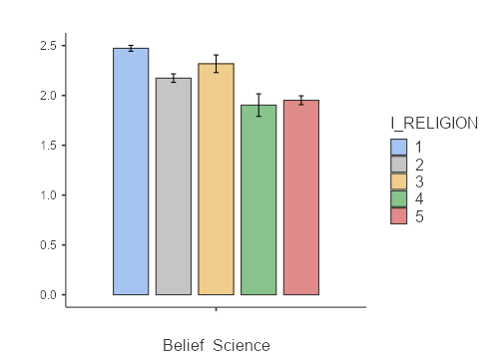
Discussion – Belief in science
It should be noted that for this factor the lower the rating the higher one’s belief in science. This seems to indicate that belief in science still varies by religious convictions. Though the difference between then is considered significant, it is very low, and therefore is less practically significant. Though again the largest difference appears between Jewish(4) and Protestant(1) belief systems, with Jewish holding the most significant belief in science, closely followed by that of Agnostic/Atheist(5).

Slide 11
Further Analysis – Spirituality
An ANOVA was conducted to compare the effect of religion type on spirituality in Protestant, Roman Catholic, Other, Jewish, and Agnostic belief systems. There was a significant effect of religion on spirituality at the p < .05 level for the five religious' beliefs, F(4,2941) = 13.7, p < .001, η_{p}² = .018. Post hoc comparisons using the Bonferroni test indicated that the mean score for Protestant (M = 2.15, SD = 0.99) was significantly different from Roman Catholic (M = 2.34, SD = 0.91), Jewish (M = 2.67, SD = 1.13), and Agnostic (M = 2.38, SD = 1.02). Post hoc comparisons using the Bonferroni test indicated that the mean score for other (M = 2.07, SD = 0.88 ) was significantly different from Jewish (M = 2.67, SD = 1.13). However, Protestant (M = 2.15, SD = 0.99) did not differ from other (M = 2.07, SD = 0.88 ). Roman Catholic (M = 2.34, SD = 0.91) did not differ from other (M = 2.07, SD = 0.88), Jewish (M = 2.67, SD = 1.13), or Agnostic (M = 2.38, SD = 1.02). Other (M = 2.07, SD = 0.88 ) did not differ from Agnostic (M = 2.38, SD = 1.02), and Jewish (M = 2.67, SD = 1.13) did not differ from Agnostic (M = 2.38, SD = 1.02).

Slide 12
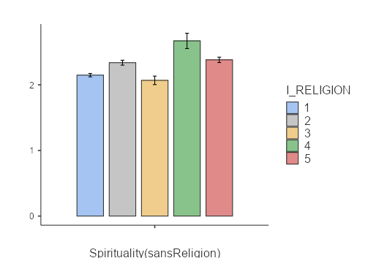
Discussion – Spirituality
It should be noted that for this factor the lower the rating the higher one’s spirituality. Though the difference between then is considered significant, it is very low, and therefore is less practically significant. However, it is interesting that the highest sense of spirituality fell under the other category(3) (Mormon, Orthodox, Muslim, Buddhist, etc.), , and the lowest being the Jewish category(4). This seems to comply with Jewish being more of a heritage than a religious conviction.

Slide 13
Overall conclusion
The remaining analyses were not considered due to extremely low effect size and bordering or insignificant p values. However, a clear conclusion can be drawn from the differing values by religious affiliation. It is clear then, that one’s religious beliefs can and do effect belief in science, belief in god and one's sense of spirituality (in the manner it was measured).

Slide 14
Sources
Jones, Robert P., Daniel Cox, and Juhem Navarro-Rivera. 'Believers, Sympathizers, & Skeptics: Why Americans Are Conflicted about Climate Change, Environmental Policy, and Science.' PRRI. 2014. http://www.prri.org/research/believers-sympathizers-skeptics-americans-conflicted-climate-change- environmental-policy-science/.

